Slide 1
Inside Windows’s Default Browser Protection

Slide 2
About Me
Xusheng Li
SDE @ Vector35 -- Binary Ninja’s debugger
Interested in malware analysis and code obfuscation

Slide 3
UCPD driver
Added to Windows in Feb 2024
Short of “User Choice Protection Driver”
It allegedly prevents unintended modification to the default browser

Slide 4
How does UCPD work?
The default browser is saved in the registry:
HKEY_CURRENT_USER\Software\Microsoft\Windows\Shell\Associations\UrlAssociations\http\UserChoice
UCPD uses CmRegisterCallbackEx to register a filter and:
prevent any binary NOT signed by Microsoft from changing this registry key
prevent various utilities from doing the same:
cmd.exe, regedit.exe, powershell.exe, etc

Slide 5
How does UCPD work?
Its intention is that the user could ONLY choose the default browser from the official settings dialog (part of explorer.exe)
No browsers can set itself as the default browser

Slide 6
How does UCPD work?
Its intention is that the user could ONLY choose the default browser from the official settings dialog (part of explorer.exe)
No browsers can set itself as the default browser
^ This is a protection for the user’s choice!

Slide 7
How does UCPD work?
Its intention is that the user could ONLY choose the default browser from the official settings dialog (part of explorer.exe)
No browsers can set itself as the default browser
Except for Edge!

Slide 8
How does UCPD work?
Its intention is that the user could ONLY choose the default browser from the official settings dialog (part of explorer.exe)
No browsers can set itself as the default browser
Except for Edge!
-- It is signed by Microsoft
-- It is not on the blocked utilities list

Slide 9


Slide 10
More details on UCPD
https://kolbi.cz/blog/2024/04/03/userchoice-protection-driver-ucpd-sys/
https://www.bleepingcomputer.com/news/microsoft/new-windows-driver-blocks-software-from-changing-default-web-browser/

Slide 11
The story goes on…
I checked the UCPD.sys in the 24H2 update (Oct 2024) and found some interesting strings in it:

Slide 12
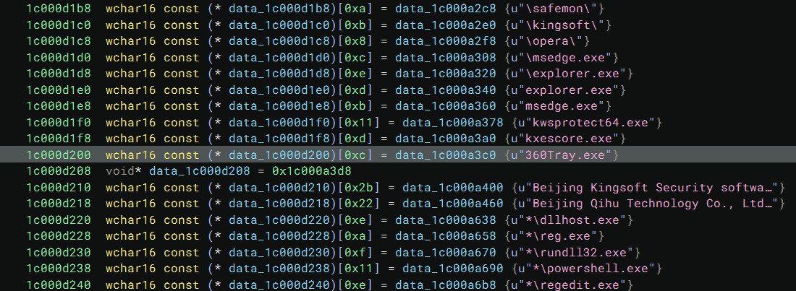

Slide 13
Lightning fast RE
UCPD monitors the creation of each process and associate it with a tag value:
explorer.exe or msedge.exe ➔ 0x8
360Tray.exe, kxescore.exe, or kwsprotect64.exe, and signed by Qihu 360 or Kingsoft → 0x4
opera.exe and signed by Opera → 0x10
etc

Slide 14
Lightning fast RE
UCPD uses ObRegisterCallbacks to monitor handle operations
When any process with a tag value 0x8 wants to get a handle to a process with a tag value 0x4:
PROCESS_VM_WRITE permission is removed
PROCESS_VM_OPERATOPN permission is removed
The operation is still permitted

Slide 15


Slide 16
What does that mean?
PROCESS_VM_WRITE and PROCESS_VM_OPERATOPN permission are required for code injection
UCPD prevents 360Tray.exe, kxescore.exe, or kwsprotect64.exe from injecting code into explorer.exe or msedge.exe
* A similar thing is done for opera.exe but we will skip it here

Slide 17
What does that mean?
UCPD prevents 360Tray.exe, kxescore.exe, or kwsprotect64.exe from injecting code into explorer.exe or msdge.exe
Why?

Slide 18
Injecting is not allowed
They tried to get around UCPD by injecting code into explorer.exe or msdge.exe
And Microsoft does not like it!

Slide 19
UCPD manager tells
The UCPD behavior is controlled by the DWORD in: HKEY_LOCAL_MACHINE\SYSTEM\ControlSet001\Srevices\UCPD\FeatureV2
The handle protection is enabled only when the bit 0x100 is set

Slide 20
UCPD manager tells
ucpdmgr.exe is a utility that can customize the behavior of UCPD
The bit can be set by ucpdmgr.exe and the relevant code called it “ANTIINJECTION”

Slide 21
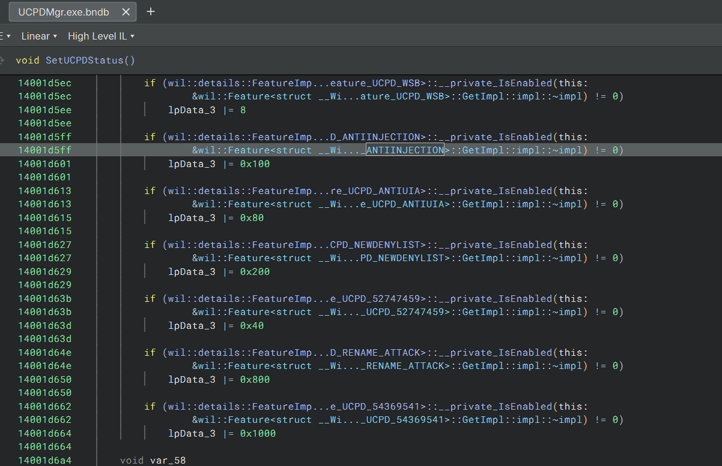

Slide 22
Summary
UCPD wants the users to only set the default browser through the settings dialog
Vendors get around it by injecting code into explorer.exe
UCPD steps up against it by calling the naughty boys by name

